Slide 1
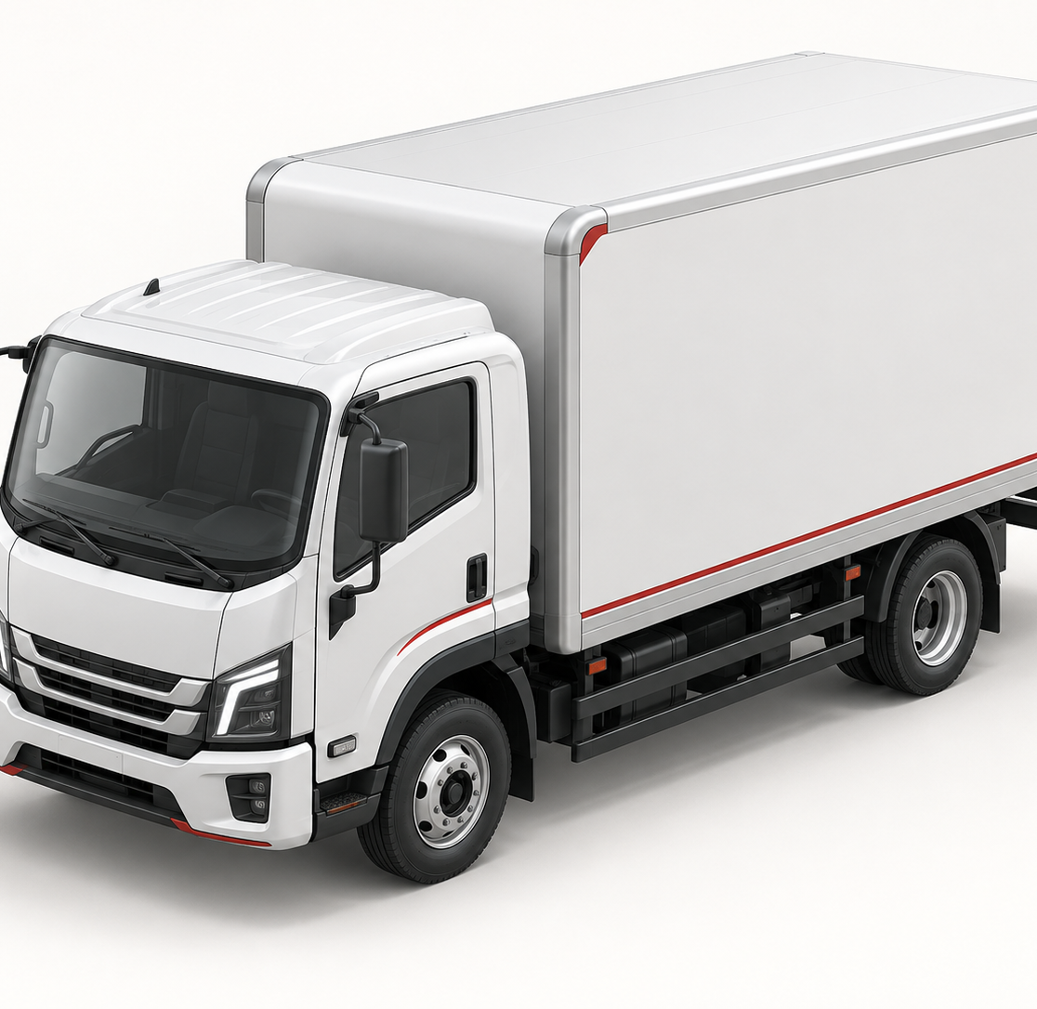
ISUZU
Strategy review prototype
How Isuzu can convert global volume recovery into resilient European aftersales growth
McKinsey / BCG style: issue-led, MECE structure, management implications, clean evidence pages
PROTOTYPE — NOT OFFICIAL ISUZU MATERIAL
Focus: HQ performance, European transition pressure, and ISZE aftersales implications
Notes:
Sources:
Generated visual asset by OpenAI image generation; no external image source.
Public source basis for Isuzu facts: FY2026 Financial Results presentation, Isuzu Motors Limited: https://www.isuzu-global.com/en/investor/financial/results/main/0111111116/teaserItems3/01111116/linkList/0/link/kessan202603e.pdf
Public source basis for D-MAX EV: Isuzu newsroom, 2025-04-29: https://www.isuzu-global.com/en/newsroom/20250429_1.html

Slide 2
Isuzu strategy review
Isuzu’s near-term challenge is not demand; it is translating volume recovery into durable profit and service stickiness
The management agenda should shift from “sell more units” to “protect profit pool, lock in uptime, and build EV-readiness without diluting core economics.”
1
2
3
4
Global volume recovered
Profit did not follow cleanly
Europe faces a transition squeeze
ISZE can become the control tower
FY2026 unit sales rose materially across CV and LCV, with LCV growth strongest after Thailand inventory normalization.
Higher unit sales and price realization were offset by tariffs, material cost, FX, expenses, and Middle East disruption.
D-MAX EV gives a compliant entry point, but range, charging speed and commercial TCO proof need disciplined positioning.
The highest-leverage move is a dealer/distributor cockpit linking GPS/PMS, SPA, BO, IDS and margin conversion.
Decision implication
Prioritize initiatives that turn installed base into recurring aftersales profit before EV/connected transition economics are fully proven.
Public sources + user-provided ISZE context; analysis indicative, not official Isuzu guidance
2
Notes:
Sources:
Isuzu FY2026 unit sales, profit drivers and FY2027 outlook are from FY2026 Financial Results presentation: https://www.isuzu-global.com/en/investor/financial/results/main/0111111116/teaserItems3/01111116/linkList/0/link/kessan202603e.pdf
Internal ISZE implications are based on user-provided context in this ChatGPT workspace, not public Isuzu guidance.

Slide 3
Global financial frame
Revenue growth returned in FY2026, but operating profit still fell—raising the bar for FY2027 execution
A classic management-consulting reading: volume is not the constraint; conversion of revenue into operating profit is the constraint.
Revenue and operating profit, FY2025–FY2027F
+8%
−¥25.8bn
Revenue growth FY26 vs FY25
Operating profit delta
¥3.48tn
¥3.70tn
¥260.0bn
Growth despite disruption; price realization and volume helped.
Profit declined despite revenue uplift, indicating conversion pressure.
¥3.24tn
¥229.5bn
¥203.7bn
¥260bn
FY27F op. profit rebound
Forecast includes approx. ¥40bn Middle East negative impact.
FY25
FY26
FY27F
FY25
FY26
FY27F
Consultant “so what”
Revenue
Operating profit
FY2027 must be managed as a margin-recovery year: price realization, supply resilience, aftersales mix and cost-to-serve discipline matter more than headline volume alone.
Public sources + user-provided ISZE context; analysis indicative, not official Isuzu guidance
3
Notes:
Sources:
FY2025/FY2026 revenue and operating profit from Isuzu FY2026 Financial Results presentation: https://www.isuzu-global.com/en/investor/financial/results/main/0111111116/teaserItems3/01111116/linkList/0/link/kessan202603e.pdf
FY2027 forecast revenue ¥3,700.0bn and operating profit ¥260.0bn from consolidated results: https://www.isuzu-global.com/en/investor/financial/results/main/0111111116/teaserItems3/01111116/linkList/03/link/con202603e.pdf
Middle East negative impact approx. ¥40.0bn from consolidated results and FY2026 presentation.

Slide 4
Volume and portfolio
The volume rebound was broad-based, but the profit question differs by portfolio
CV and LCV both grew; the management issue is which pools convert into service, parts, and uptime revenue under regional constraints.
Global sales units, FY2025 vs FY2026
Implication by business pool
CV
Uptime + service retention
577k
Convert fleet utilization into maintenance share and predictive support.
539k
LCV 230
LCV 253
LCV
Market recovery + EV transition
Protect D-MAX diesel economics while preparing BEV value proof.
CV 309
CV 324
Aftermarket
Highest controllable lever
Pricing, SPA discipline, GPS/PMS and BO reduction can move profit faster than new model cycles.
FY25
FY26
CV
LCV
Europe/ISZE lens
Treat the installed base as the economic bridge between today’s ICE fleet and tomorrow’s EV/connected services portfolio.
Public sources + user-provided ISZE context; analysis indicative, not official Isuzu guidance
4
Notes:
Sources:
FY2025/FY2026 global CV and LCV sales units from Isuzu FY2026 Financial Results presentation: https://www.isuzu-global.com/en/investor/financial/results/main/0111111116/teaserItems3/01111116/linkList/0/link/kessan202603e.pdf
Aftermarket implications are analytical interpretation based on user-provided ISZE context.

Slide 5
Strategic agenda
Isuzu’s 2030 agenda can be managed as three horizons with different economics and time-to-impact
The core portfolio funds the transition; connected/uptime services defend retention; carbon-neutral and autonomy options create future relevance.
Horizon 1
Horizon 2
Horizon 3
Strengthen core CV / LCV and aftermarket
Scale connected uptime and service support
Build CN + autonomous growth options
Product competitiveness, price realization, supply chain stability, dealer service execution
Operational support services, connected data, dealer efficiency, customer uptime KPIs
EVs across categories by 2030, energy solutions, L4 demonstrations and new business models
Cash engine
Retention engine
Future option
Management principle
Do not let the future agenda cannibalize management focus from today’s profit engine; sequence investments around measurable customer uptime and margin conversion.
Public sources + user-provided ISZE context; analysis indicative, not official Isuzu guidance
5
Notes:
Sources:
Mid-term management policy and three strategic areas from Isuzu Integrated Report 2025: https://www.isuzu.co.jp/world/company/investor/financial/pdf/integrated_report25_04.pdf
Integrated report references FY2027 interim targets, connected services expansion, carbon-neutral solutions by 2030, and L4 autonomous driving solution demonstration/monitoring plans.

Slide 6
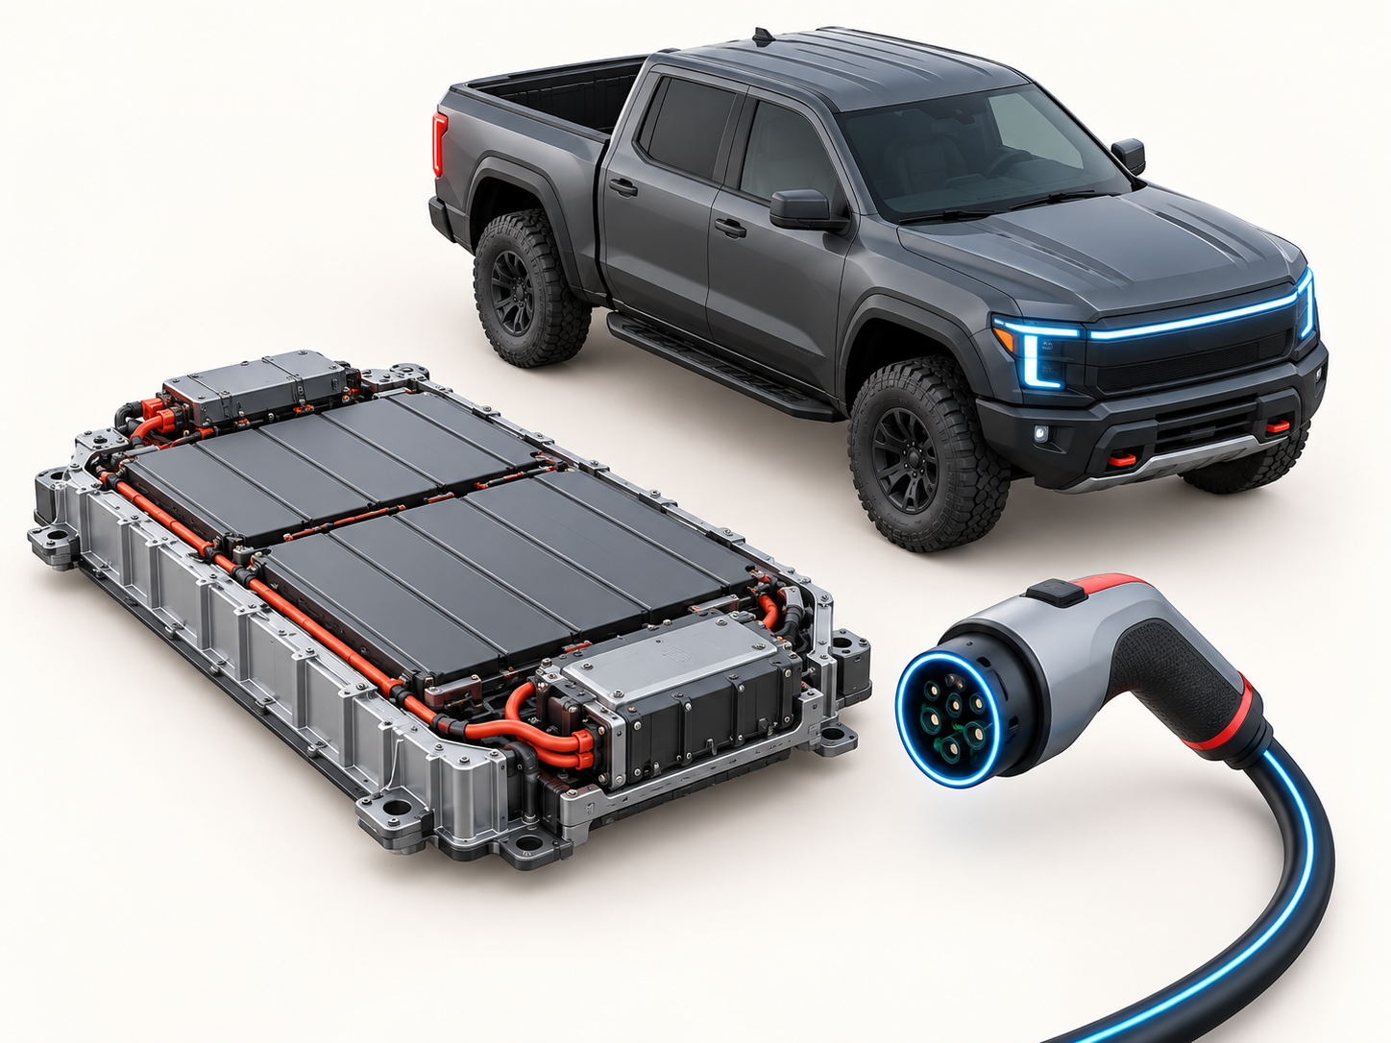
D-MAX EV strategic scan
D-MAX EV gives Europe a credible entry point, but the value proposition must be sold through use-case economics
The product has commercial-truck strengths—payload and towing—while charging speed and WLTP range make fleet use-case selection critical.
Commercial positioning scorecard
Payload
1,010 kg
Strength vs lifestyle EV pickups
Towing
3,500 kg
Keeps work-truck credibility
Range
263 km WLTP
Depot / regional routes first
Charging
DC 50 kW
Not yet “high-throughput” fleet charging
Battery
66.9 kWh
Weight / payload trade-off to manage
ISZE implication
Prepare EV parts, warranty, charging-use-case and TCO materials now; do not wait until BEV volume is material.
Public sources + user-provided ISZE context; analysis indicative, not official Isuzu guidance
6
Notes:
Sources:
D-MAX EV production timing and key specifications from Isuzu newsroom, 2025-04-29: https://www.isuzu-global.com/en/newsroom/20250429_1.html
Analysis of use-case implications is interpretive, based on payload/towing/range/charging specifications.

Slide 7
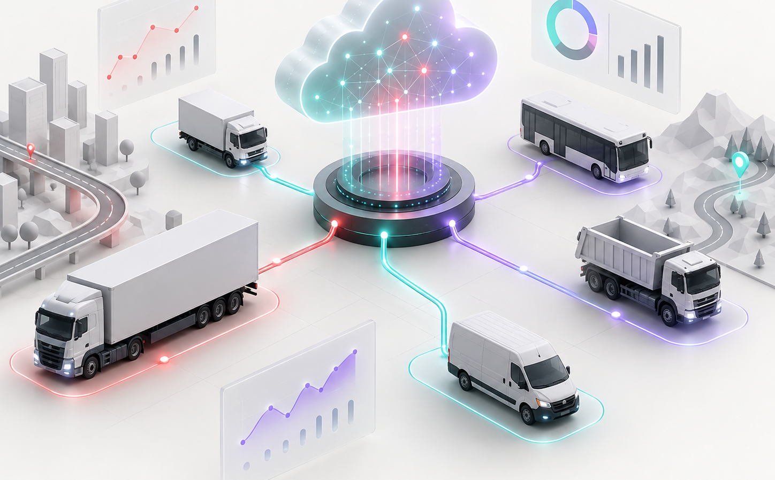
ISZE aftersales agenda
ISZE should evolve from reporting center to margin-and-uptime control tower
The aftersales profit pool is most actionable when SPA, GPS/PMS, BO and dealer efficiency are managed as one operating system.
Control tower logic
1
Demand capture
GPS / PMS share, UIO coverage, dealer order mix
2
Price discipline
SPA approval logic, class/factor control, post-SPA GP delta
3
Service reliability
BO root causes, RUSH/VOR/SVOR signals, replenishment logic
4
Dealer productivity
IDS dashboard, section benchmarking, kaizen actions
Design rule
Every management page should answer: where is profit leaking, who owns it, and what action changes next month?
SPA GP delta
GPS/PMS share
BO ageing
Dealer IDS
before vs after
target vs actual
root cause
vs network avg
Public sources + user-provided ISZE context; analysis indicative, not official Isuzu guidance
7
Notes:
Sources:
ISZE levers and terminology are based on user-provided internal context in this ChatGPT workspace: SPA, GPS, PMS, BO, IDS, UIO and VP-4 reporting logic.
Generated fleet-management visual asset by OpenAI image generation; no external image source.

Slide 8
Recommended roadmap
Recommended roadmap: make the next 12 months a margin-conversion program, not only a reporting refresh
A McKinsey/BCG-style recommendation is only useful if it is translated into ownership, cadence and decision rights.
0–90 days
3–6 months
6–9 months
9–12 months
Establish one source of truth
Run profit sprints
Deploy dealer efficiency loop
Prepare EV service playbook
Align monthly scorecard: BP, LY, GP/GM, GPS/PMS, SPA delta, BO and IDS views. Freeze definitions and owners.
Select 2–3 markets and run SPA / PMS / BO interventions with pre-post profit tracking and dealer feedback.
Use IDS benchmarking to target dealer sections, service behaviors and training actions with quantified follow-up.
Codify D-MAX EV parts, warranty, charging use cases, TCO support and aftersales readiness for early markets.
Leadership decision required
Choose whether this becomes an ISZE operating cadence with monthly distributor actions, or remains a one-off reporting improvement.
Public sources + user-provided ISZE context; analysis indicative, not official Isuzu guidance
8
Notes:
Sources:
Roadmap is a recommendation based on public Isuzu strategic direction plus user-provided ISZE aftersales context.
Public Isuzu strategic context from Integrated Report 2025: https://www.isuzu.co.jp/world/company/investor/financial/pdf/integrated_report25_04.pdf
D-MAX EV service-readiness context from Isuzu newsroom: https://www.isuzu-global.com/en/newsroom/20250429_1.html

